Slide 1



DIGITAL PORTFOLIO
NAME: ASFAR BANU. M.B
﻿REGISTER NO: 24134130500122005
NMID: ASANM41341324213005
20EFE77B6D3F7B4B5E74EE5C684EFF7F
DEPARTMENT: BCA
COLLEGE: DEEN COLLEGE OF ARTS AND SCIENCE NIDUR-KADUVANGUDI

Slide 2
Student
digital
portfolio

Slide 3
AGENDA
☆Problem Statement
☆ Project Overview
☆ End Users
☆ Tools and Technologies
★ Portfolio design and Layout
✩ Features and Functionality
☆Results and Screenshots
☆Conclusion
☆Github Link

Slide 4
PROBLEM STATEMENT
Students often lack a structured digital platform to display their skills, projects, and achievements in a professional manner.

Slide 5
Project Overview
A responsive student digital portfolio website was developed using HTML, CSS, and JavaScript to present personal information, projects, and services clearly

Slide 6
WHO ARE THE ﻿END USERS?
Students - to showcase their academic and technical profile.
Recruiters/Employers - to evaluate skills and contact easily.
Teachers/Peers - to review and provide feedback.

Slide 7
TOOLS AND TECHNOLOGIES
HTML Structure of the website.
CSS (Style.css) → Main design and layout.
Responsive CSS (style2.css) Mobile and tablet responsiveness.
JavaScript → Interactive hamburger menu for navigation.

Slide 8
PORTFOLIO DESIGN AND LAYOUT
Sections included: Home, Portfolio, About, Services, Contact, and Footer.
Simple, professional design with a responsive navbar and card-based portfolio section

Slide 9
FEATURES AND FUNCTIONALITY
Responsive design (works on desktop, tablet, and mobile).
Hamburger menu for mobile navigation.
Portfolio cards with images and headings.
Contact form with personal details section.

Slide 10
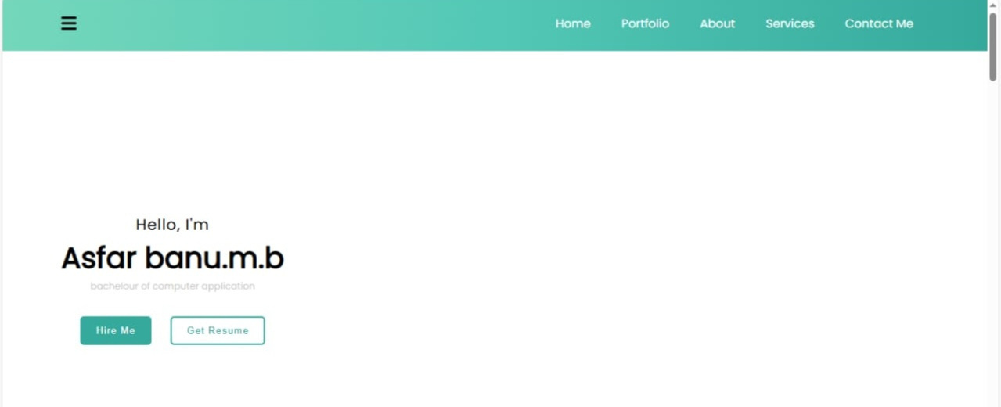
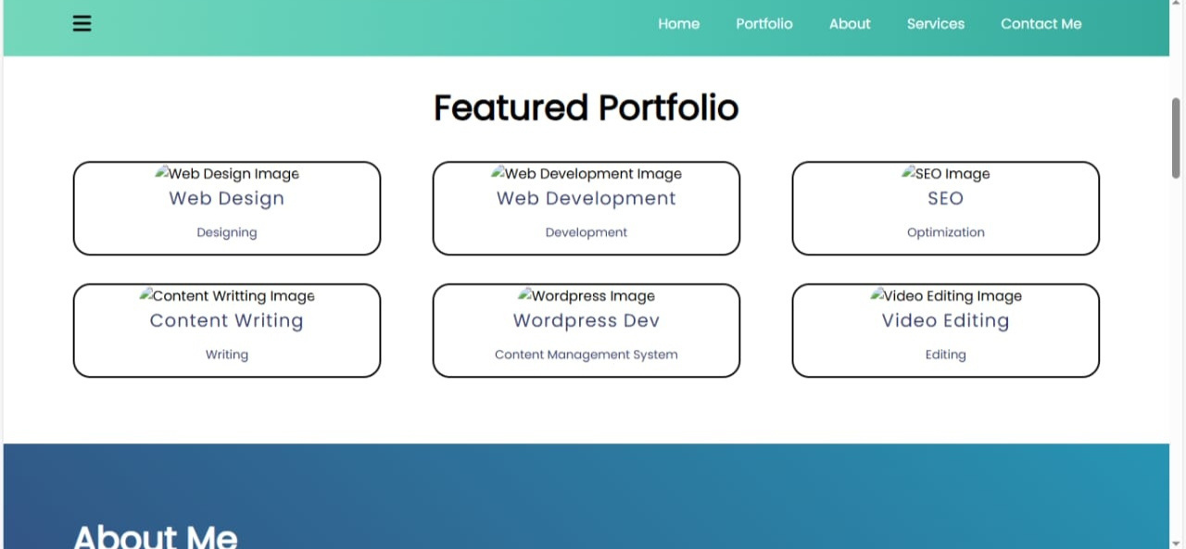
RESULTS AND SCREENSHOTS

Slide 11
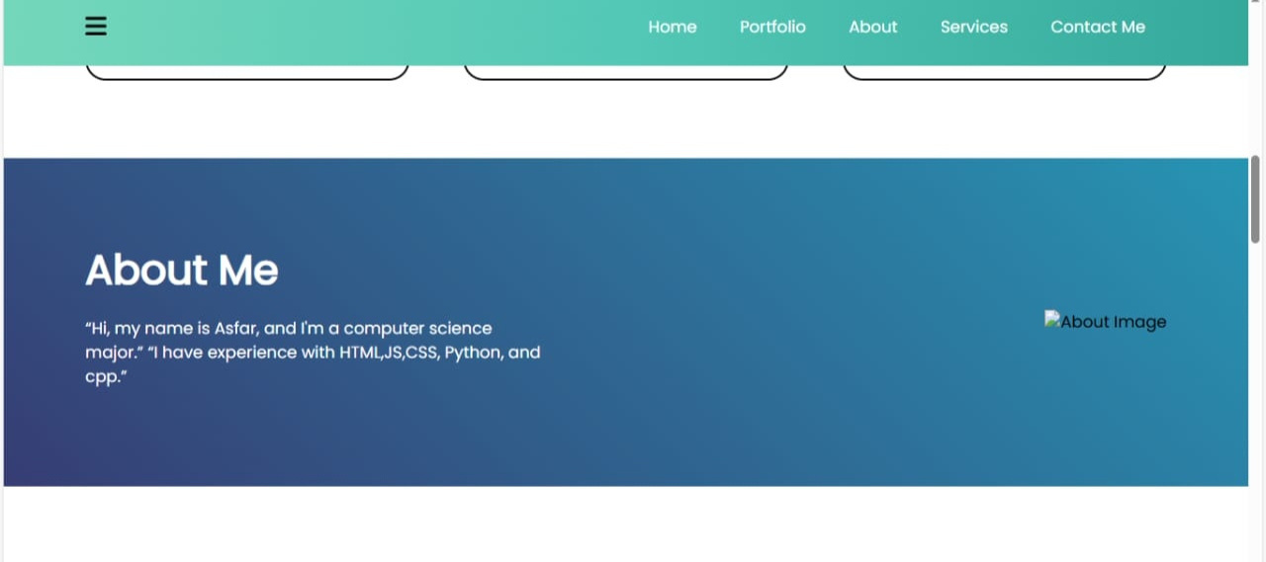
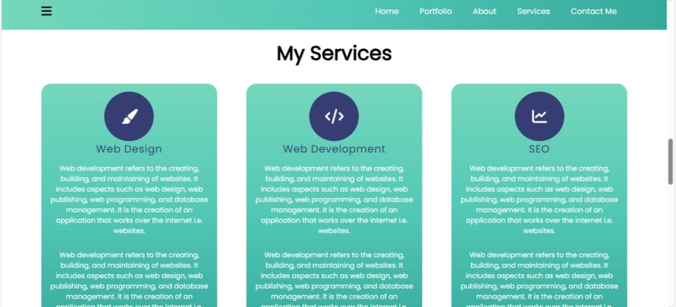

Slide 12
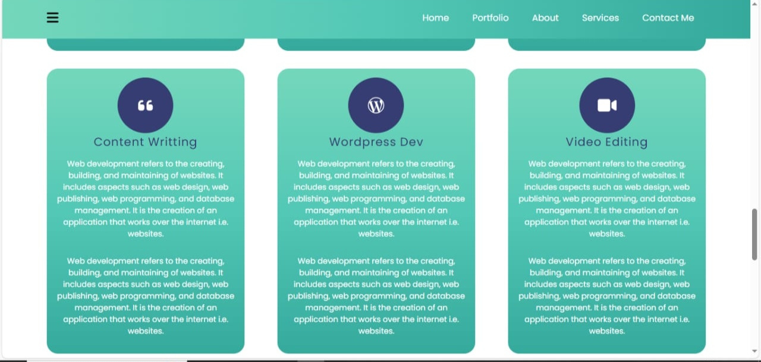
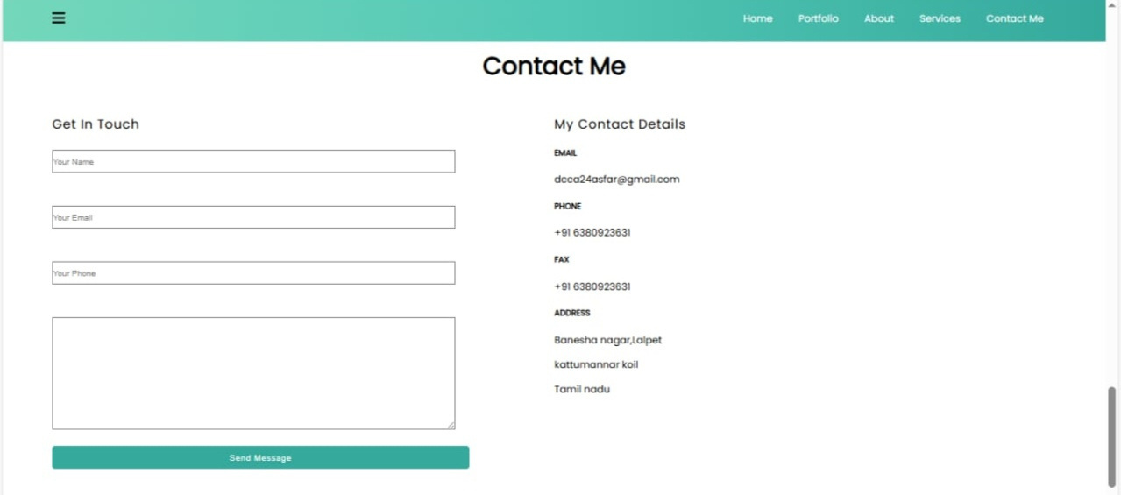

Slide 13
Conclusion
The Student Portfolio Website is an effective tool for students to showcase their academic journey, projects, and technical skills. It serves as a digital resume and makes a strong first impression on recruiters and faculty.

Slide 14
GITHUB LINK
https://github.com/dcca24asfar/Asfar-TNSDC-FWD-DP.git

